Slide 1
Beyond the Spectrum

Slide 2
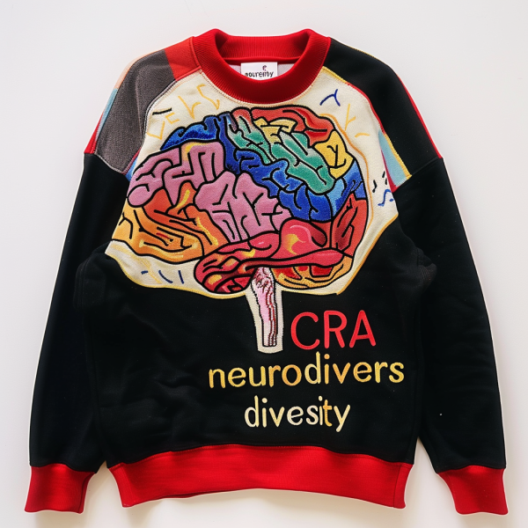
Understanding Neurodiversity
Neurodiversity refers to the natural variation in human brain function and behavior, emphasizing that neurological differences such as autism, ADHD, and dyslexia are part of human diversity rather than deficits.
Notes:
Recognizing neurodiversity fosters inclusivity and understanding, allowing minority neurodivergent youth to thrive by promoting acceptance and reducing stigma associated with their conditions.
Supporting neurodivergent youth is crucial for their personal growth and societal contribution, as it enhances their self-esteem, social skills, and overall well-being through tailored therapeutic interventions.

Slide 3
Prevalence of Autism by Year
Surveillance Year | Birth Year | Number of ADDM Sites Reporting | Combined Prevalence per 1,000 Children (Range Across ADDM Sites) | This is about 1 in X children
2020 | 2012 | 11 | 27.6 (23.1-44.9) | 1 in 36
2018 | 2010 | 11 | 23.0 (16.5-38.9) | 1 in 44
2016 | 2008 | 11 | 18.5 (18.0-19.1) | 1 in 54
2014 | 2006 | 11 | 16.8 (13.1-29.3) | 1 in 59
2012 | 2004 | 11 | 14.5 (8.2-24.6) | 1 in 69
2010 | 2002 | 11 | 14.7 (5.7-21.9) | 1 in 68
2008 | 2000 | 14 | 11.3 (4.8-21.2) | 1 in 88
2006 | 1998 | 11 | 9.0 (4.2-12.1) | 1 in 110
2004 | 1996 | 8 | 8.0 (4.6-9.8) | 1 in 125
2002 | 1994 | 14 | 6.6 (3.3-10.6) | 1 in 150
2000 | 1992 | 6 | 6.7 (4.5-9.9) | 1 in 150
Notes:
Increasing Prevalence: The prevalence of ASD has increased significantly from 2000 to 2020. In 2000, the prevalence was 6.7 per 1,000 children (about 1 in 150), while in 2020, it was 27.6 per 1,000 children (about 1 in 36).
Consistency in Reporting Sites: The number of ADDM sites reporting data has remained relatively consistent, with 11 sites reporting in most years. This consistency helps ensure the reliability of the data over time.
Range of Prevalence: The range of prevalence across different ADDM sites shows variability, indicating that some regions have higher or lower rates of ASD diagnosis. For example, in 2020, the range was 23.1 to 44.9 per 1,000 children.
Yearly Trends: Each surveillance year shows a gradual increase in the prevalence rate, reflecting either an increase in the actual incidence of ASD, better diagnostic practices, or a combination of both.

Slide 4



Challenges Faced by Minority Neurodivergent Youth
Access to Resources
Educational Inequities
Notes:
Minority children often face significant barriers in accessing therapeutic services due to systemic inequities, including geographic isolation and a shortage of culturally competent providers in their communities. Many families struggle with financial limitations that prevent them from affording necessary therapeutic services, particularly when insurance coverage is inadequate or non-existent for mental health care.
These youth frequently face inadequate educational resources and support systems that fail to accommodate their unique learning needs, resulting in lower academic achievement and increased feelings of isolation, further complicating their social interactions and mental health.
This leads me to the supporting data I found regarding this.

Slide 5
How Beyond the Spectrum Helps
Access to Resources
- Our organization bridges the gap between underserved families and essential therapeutic resources, facilitating access to care that is often delayed or unavailable due to systemic barriers.
Community Engagement Initiatives
- We actively engage with local communities to raise awareness about mental health, promote inclusivity, and empower families to advocate for their children's therapeutic needs.

Slide 6
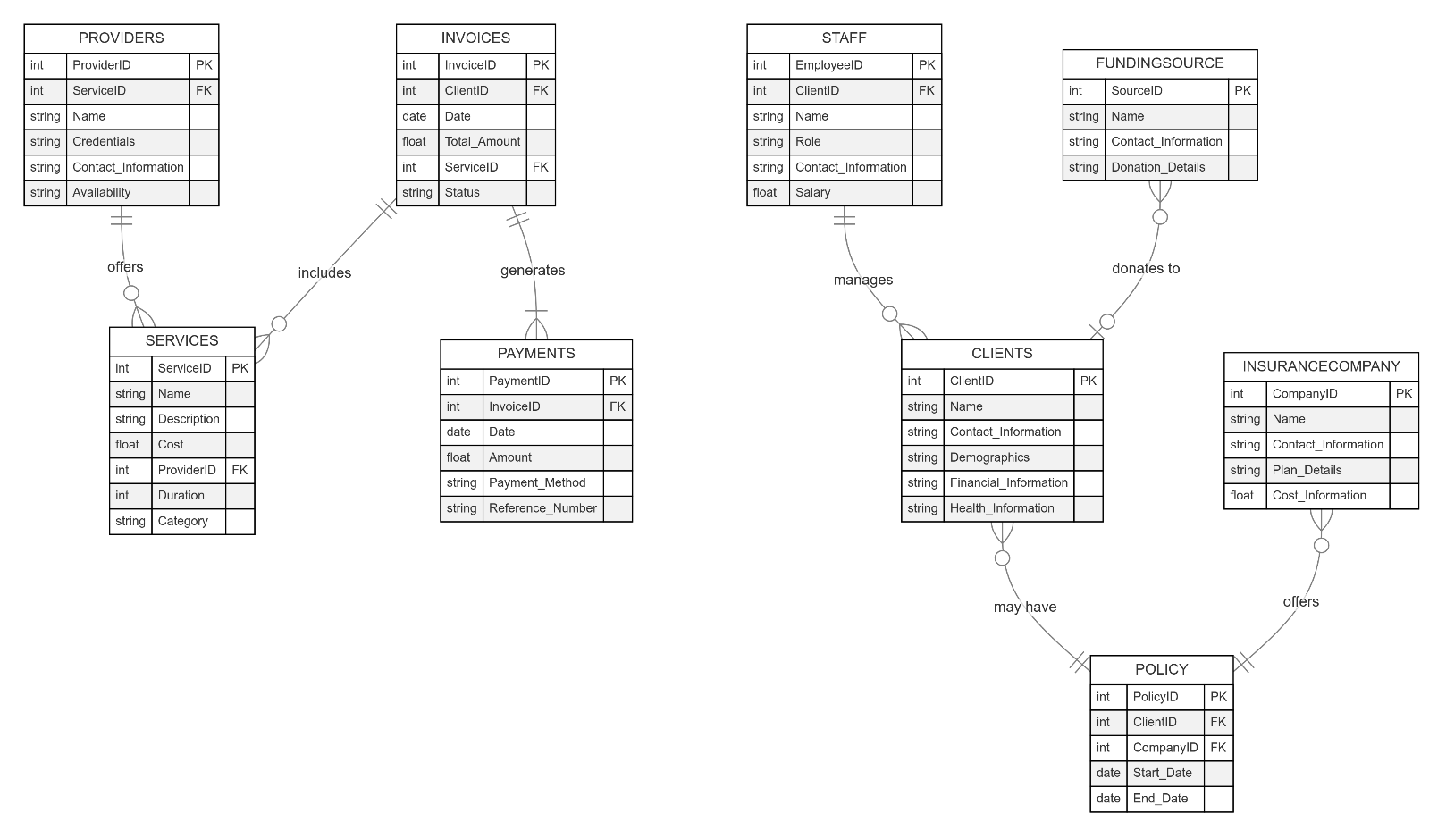
Our Business Model
Notes:
Entities
PROVIDERS: Represents healthcare providers (doctors, nurses, etc.).
INVOICES: Represents invoices generated for services provided.
STAFF: Represents employees of the healthcare facility.
FUNDINGSOURCE: Represents sources of funding for the facility (e.g., grants, donations).
SERVICES: Represents the types of healthcare services offered.
PAYMENTS: Represents payments made on invoices.
CLIENTS: Represents patients or clients of the healthcare facility.
INSURANCECOMPANY: Represents insurance companies that work with the facility.
POLICY: Represents insurance policies held by clients.
Relationships
One-to-Many:
A provider can offer many services.
An invoice can include many services.
A staff member can manage many clients.
A funding source can donate to many clients.
A client can have many policies.
An insurance company can offer many policies.
Many-to-Many:
A service can be included in many invoices.
A client can generate many payments.
A client can be managed by many staff members.
A client can donate to many funding sources.
A policy can be associated with many clients.
Data Flow and Business Processes
Based on the ERD, we can infer the following business processes:
Service Provision: Providers offer services to clients.
Invoicing: Services rendered result in invoices generated for clients.
Payment Processing: Clients make payments on invoices.
Insurance Claims: Clients with insurance submit claims to their insurance companies.
Staff Management: Staff members manage clients and services.
Financial Management: The facility manages funding sources, payments, and insurance claims.

Slide 7
Thank you!

